Slide 1
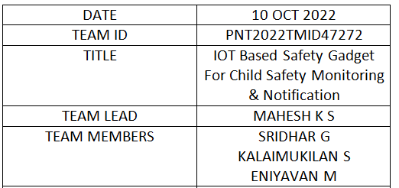
Technology Architecture

Slide 2
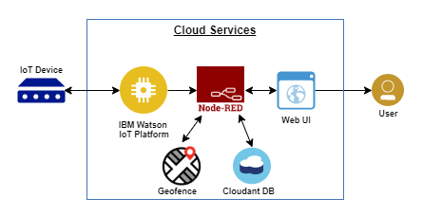

Slide 3
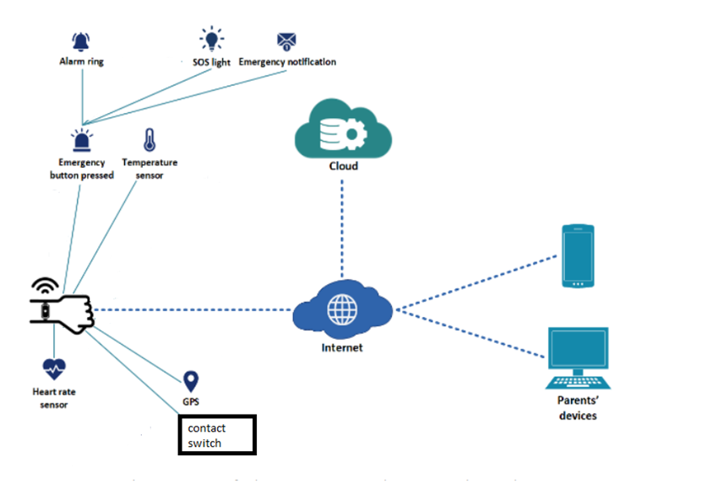

Slide 4
Gadget
(iot device)
User(parents)
Ibm cloud
cloudant
Web/UI
Ibm watson platform
Node-red
location

